Slide 1
Error Management

Slide 2
Overview
The core competency that we have chosen this week is Exception types and scope. Here we will learn more about the compilation errors as well as understanding run-time errors.

Slide 3

compilation errors
Are generally typing errors. The parsing of your PL/SQL text file into a set of interpreted instructions, known as p-code, finds lexical errors. Lexical errors occur when you misuse a delimiter, identifier, literal, or comment.
You can misuse lexical units by: 1. Forgetting a semicolon (the statement terminator) 2. Using only one delimiter when you should use two 3. Misspelling an identifier 4. Commenting out a lexical value required by the parsing rules
There are three general patterns for error messages: 1. Prior line errors (Point to an error on the prior statement line. It’s generally a missing statement terminator.) 2. Current line errors (Point to the column of the error or one column after the error. It means that the parser is looking for a missing lexical unit.) 3. Declaration errors (Point to any failure in the declaration block and has the actual error line as the last line of the error message.)

Slide 4
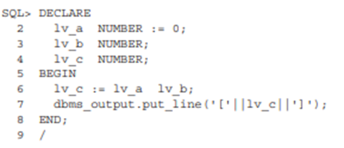
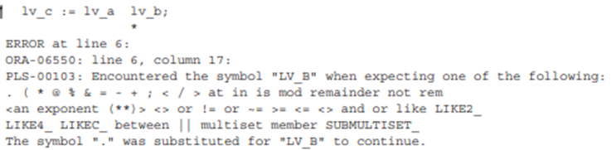
Example
The next example shows a compilation error where the error occurs on the same line:
The error message displayed is:
The PLS-00103 error message says that a lexical unit is missing immediately before the variable lv_b. The asterisk on the second line below the variable lv_b tells you that the error occurs immediately before the variable. You can fix this program by placing any arithmetic operator in between the lv_a and lv_b variables.

Slide 5
Defining Runtime Errors
A runtime error is an error that appears while your application is running.
Runtime errors are the first error that an end user will see.
These errors are typical in any application

Slide 6
Causes/Consequences
Some runtime errors are due to leaky abstractions
Unknown runtime errors are the result of invalid assumptions
Often these errors occur due to missing variable initialization or improper nesting of blocks of code
Consequences could be that this could cause a hard crash in the system
If you don’t have automated error reporting, then the developer may never know about the runtime errors
They can be very costly if these happen during a modifying process (INSERTs, UPDATEs, DELETEs, ect).

Slide 7
References
Oracle Database 12c PL/SQL Programming (byui.edu)
https://nolongerset.com/runtime-errors/#:~:text=A%20runtime%20error%20is%20an,your%20end%20users%20will%20see.

Slide 8
Thank you!
Tim Smith
Fiona Schwallie

